Slide 1

IPL AUCTION SIMULATION
Python for Computational Problem Solving
UE23CS151A – Semester I – Mini Project
Aspiring Auctioneers
Sumit Nair Sourish Joshi Tanmay Sankolli
Swabhav D
Under the guidance of: Prof. Gayatri R.S
Assistant Professor Department of Computer Science Engineering
PES University

Slide 2
Roles and Responsibilities
Sumit Nair | PES1UG23AM324 | Main Auction Page and Logic
Sourish Joshi | PES1UG23EE051 | Final Teams Page and Presentation
Tanmay Sankolli | PES1UG23EC323 | Choose Teams Page and Presentation
Swabhav D | PES1UG23EC316 | Database Management

Slide 3
Table of Contents
01
02
03
04
05
Modules
Used
Problem Statement
Implementation Details
06
Results
and Discussion
Learnings from the Project
Conclusions and Future Work

Slide 4
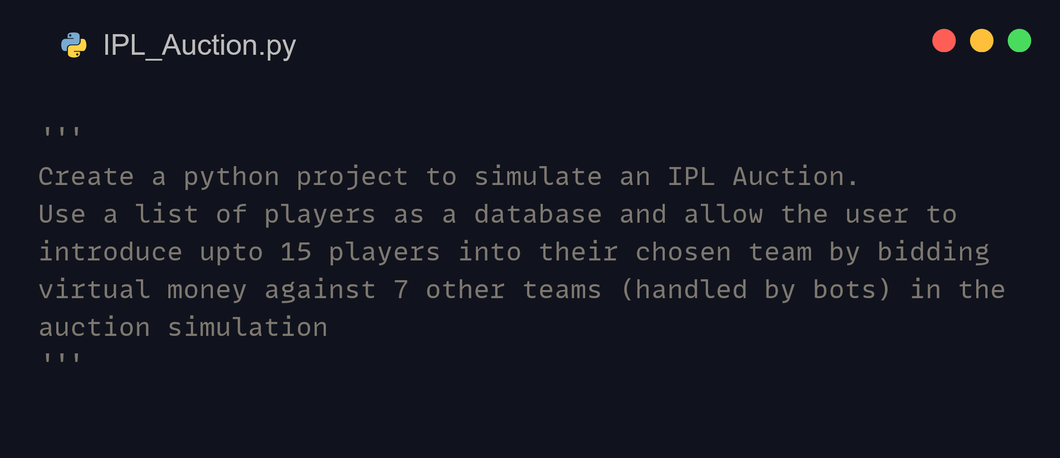
PROBLEM STATEMENT

Slide 5
Modules Used

Slide 6



Tkinter It is the standard Python interface to the Tk GUI toolkit, and is Python’s standard to implement GUI’s for programs.
CustomTkinter tkinter extension which provides extra ui-elements like the buttons and themes

Slide 7



Auction_lib
PIL
The Python Imaging Library, or PIL/Pillow, adds image processing capabilities to your Python interpreter, with extensive file format support
Auction_lib Custom made library to handle the auctioneering logic of the program
MySQL Connector A self-contained Python driver for communicating with MySQL servers

Slide 8





random
This module implements
pseudo-random number generators for various distributions
time This module
provides various
time-related functions like sleep(), which helps to pause the program when necessary
io
The io module
provides Python’s main facilities for dealing with various types of I/O
base64
This module
provides functions for encoding binary data to printable ASCII characters and decoding such encodings back to binary data, in the base64 algorithm
gc
This module
provides an interface to the optional garbage collector. It provides the ability to disable it, tune the collection frequency, and set debugging options

Slide 9
Implementation Details

Slide 10
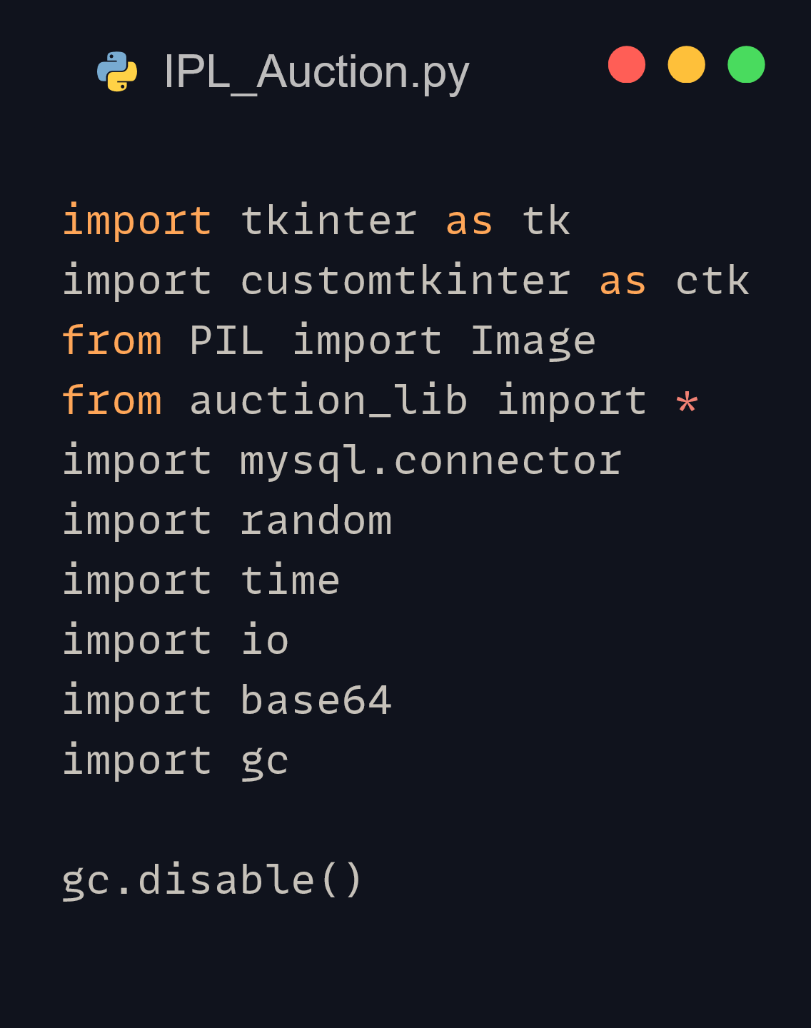
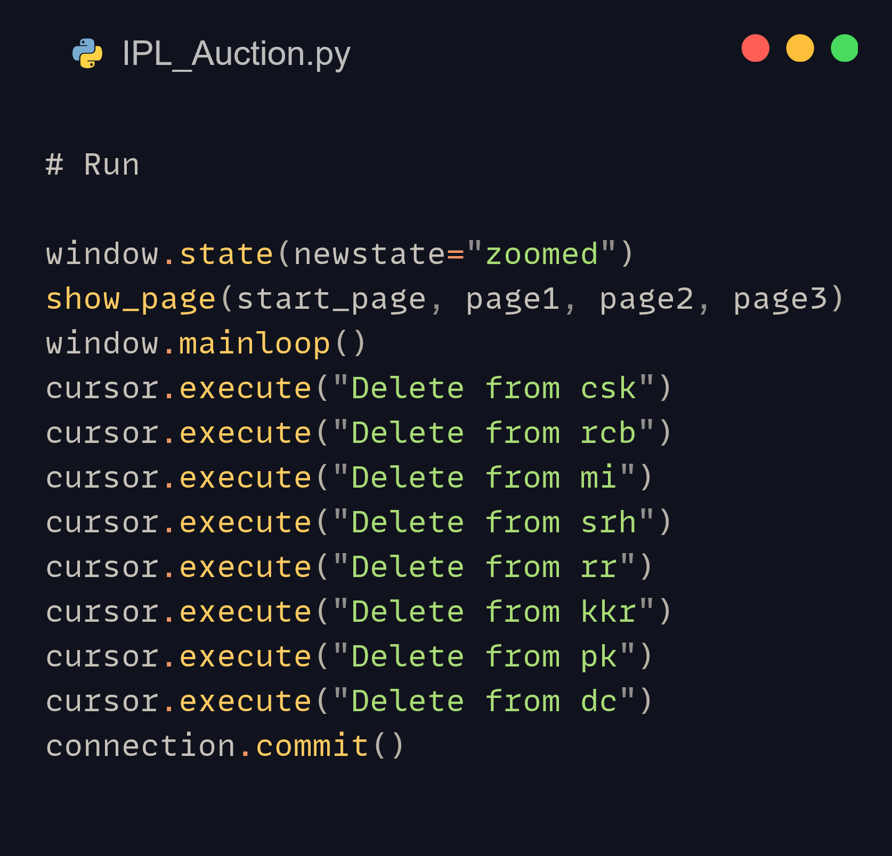
Importing of Modules and Disabling the Garbage Collector
Commands which run when the program is closed

Slide 11
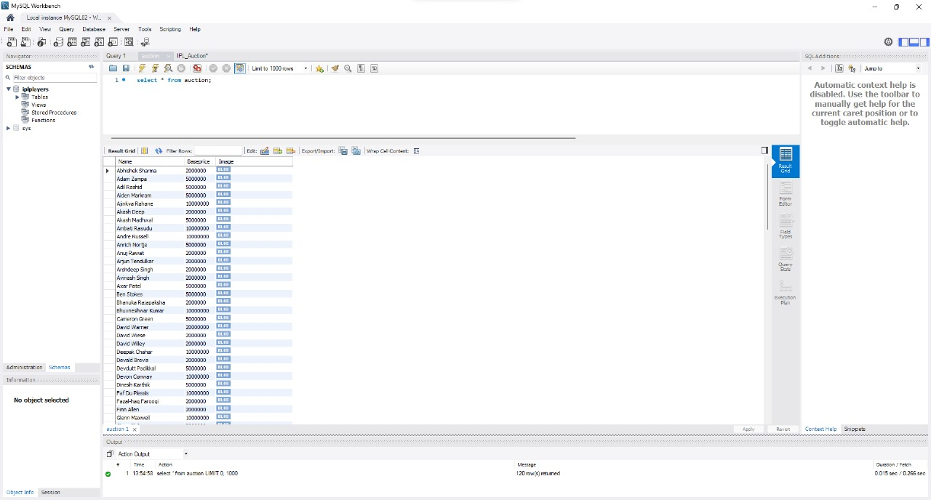
Database Table of Players with their Base Prices and Images made in MySQL Workbench

Slide 12
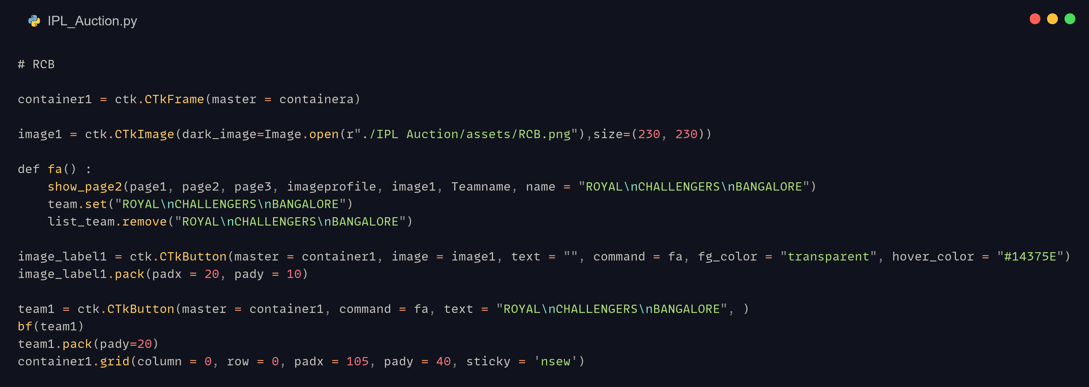
tKinter Code Snippet for a single team on the “Choose your Own Team” screen (Page 1). This snippet displays the team with its image, which you can click on

Slide 13
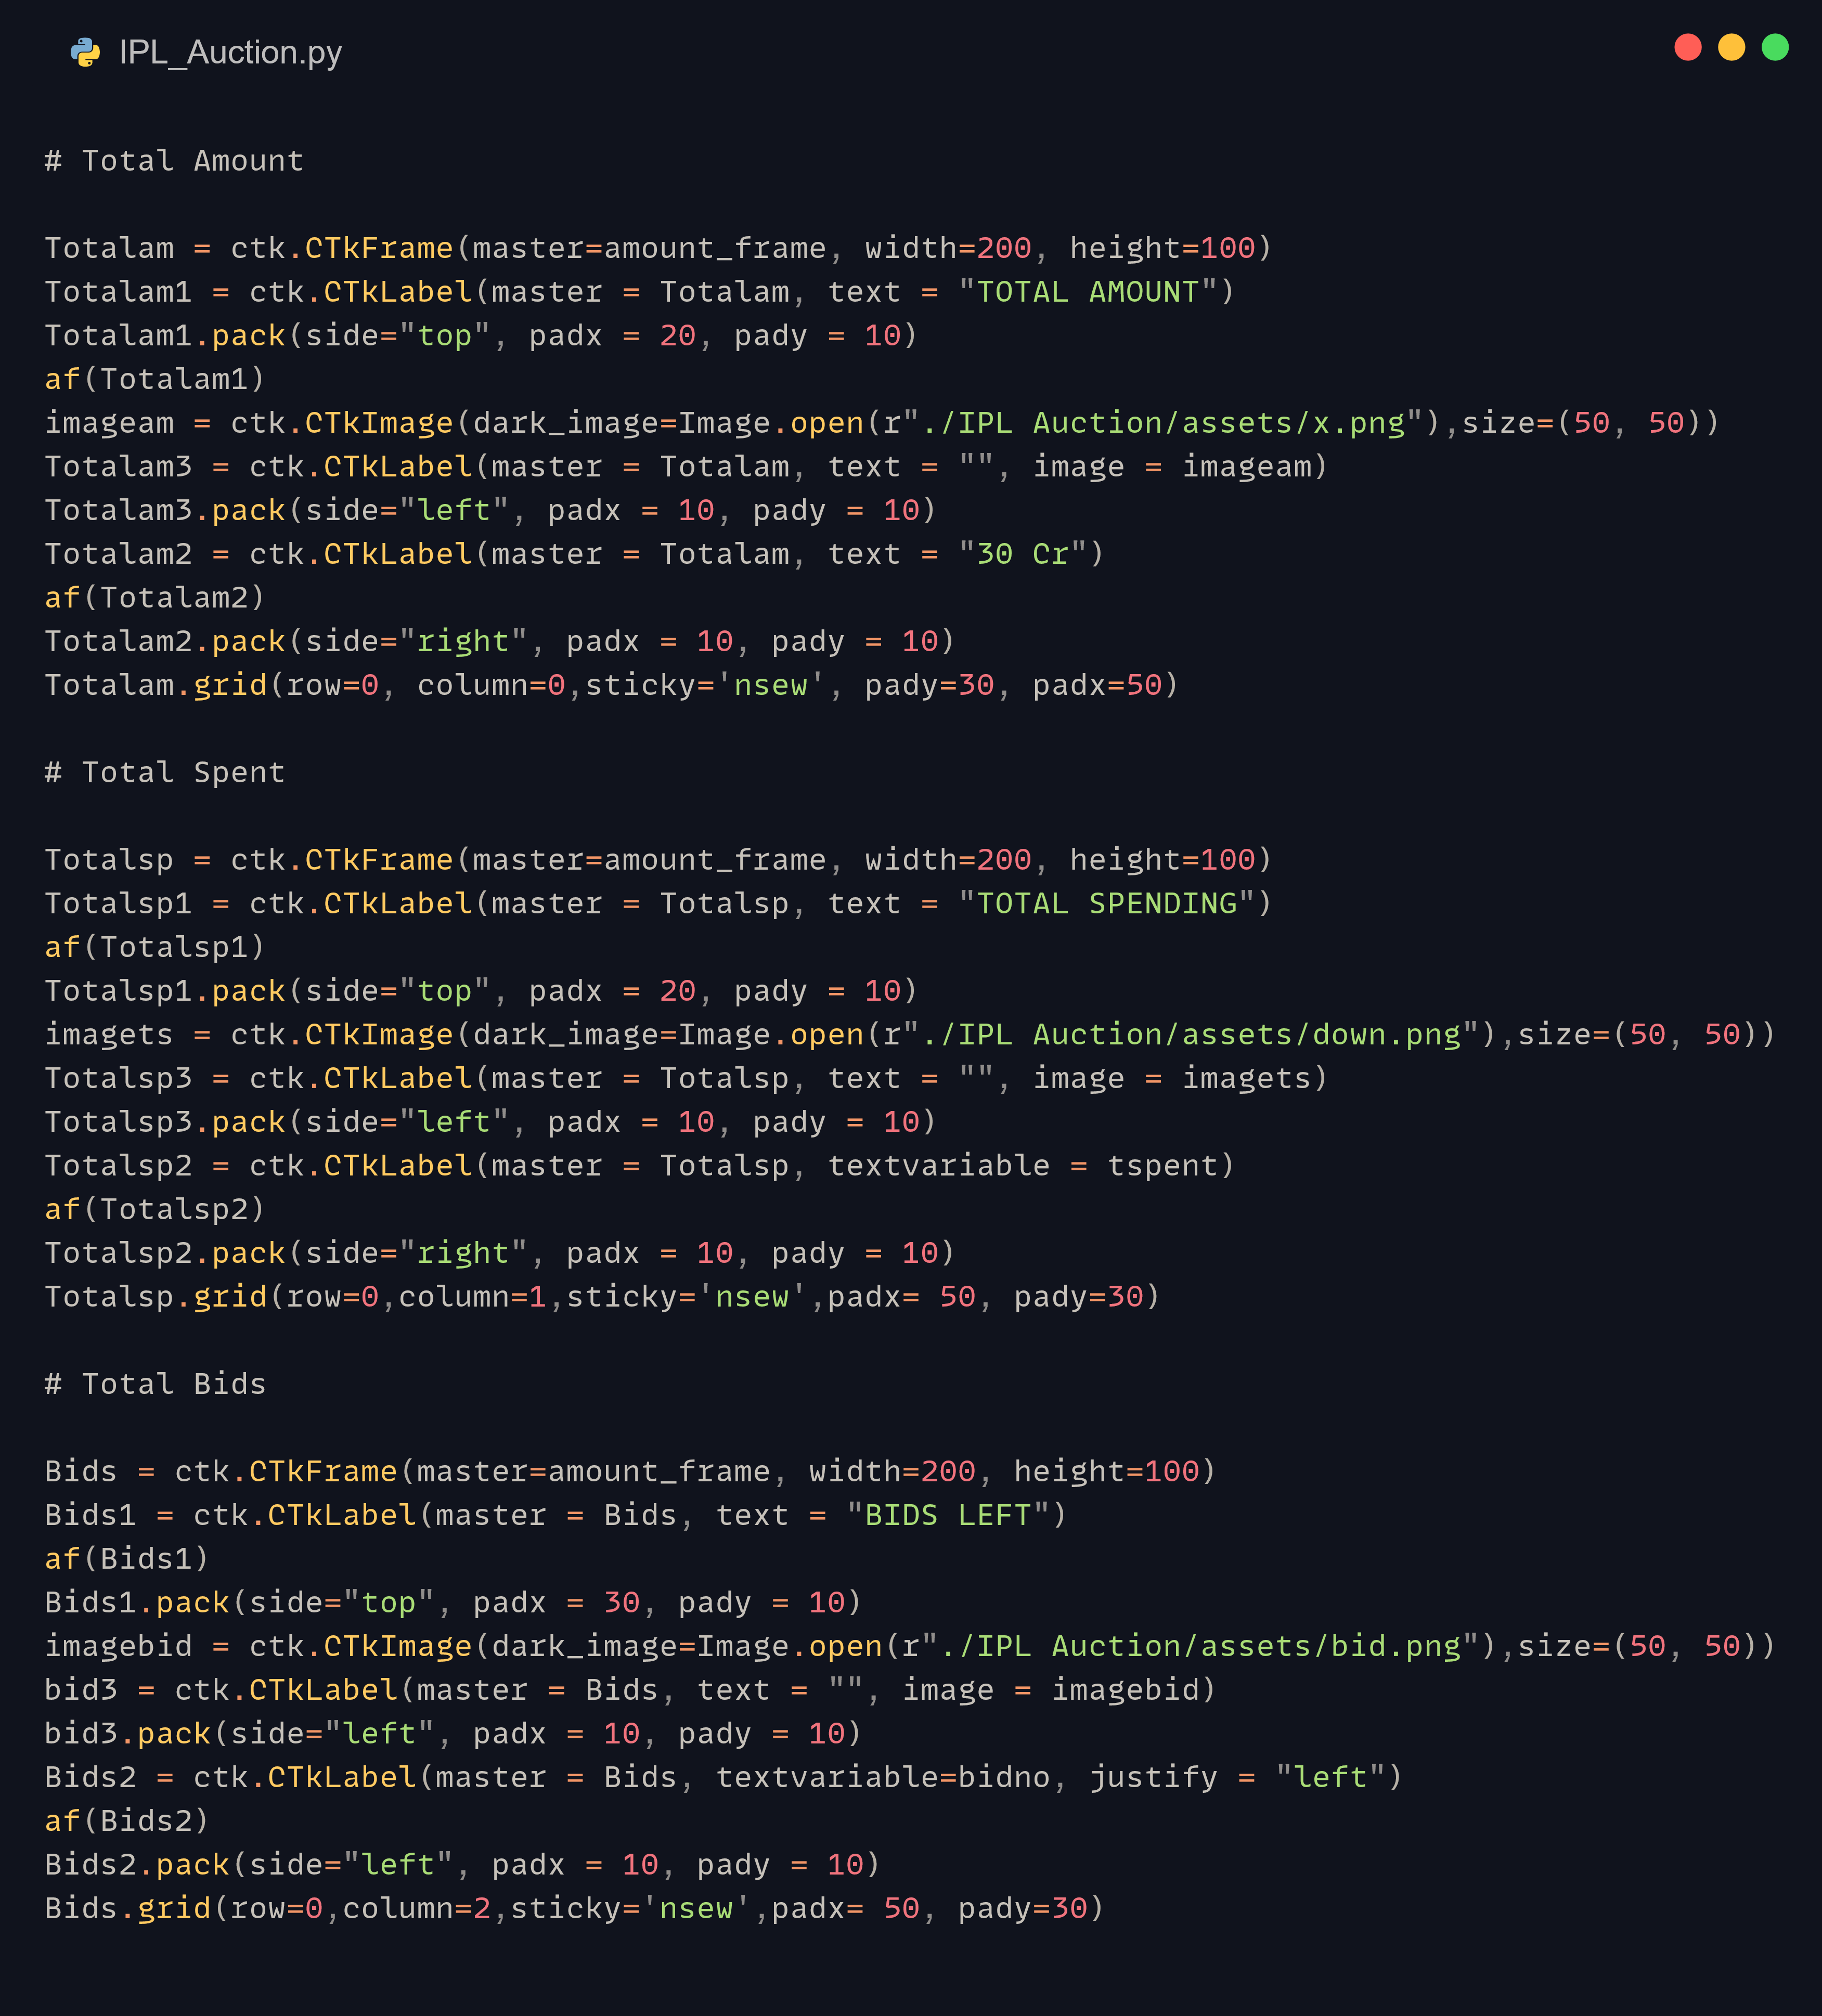
tKinter Code Snippet for the Main Auction Screen (Page 2). It displays the Total Amount Left, the Total Amount Spent, and the Total number of Bids that have been made

Slide 14
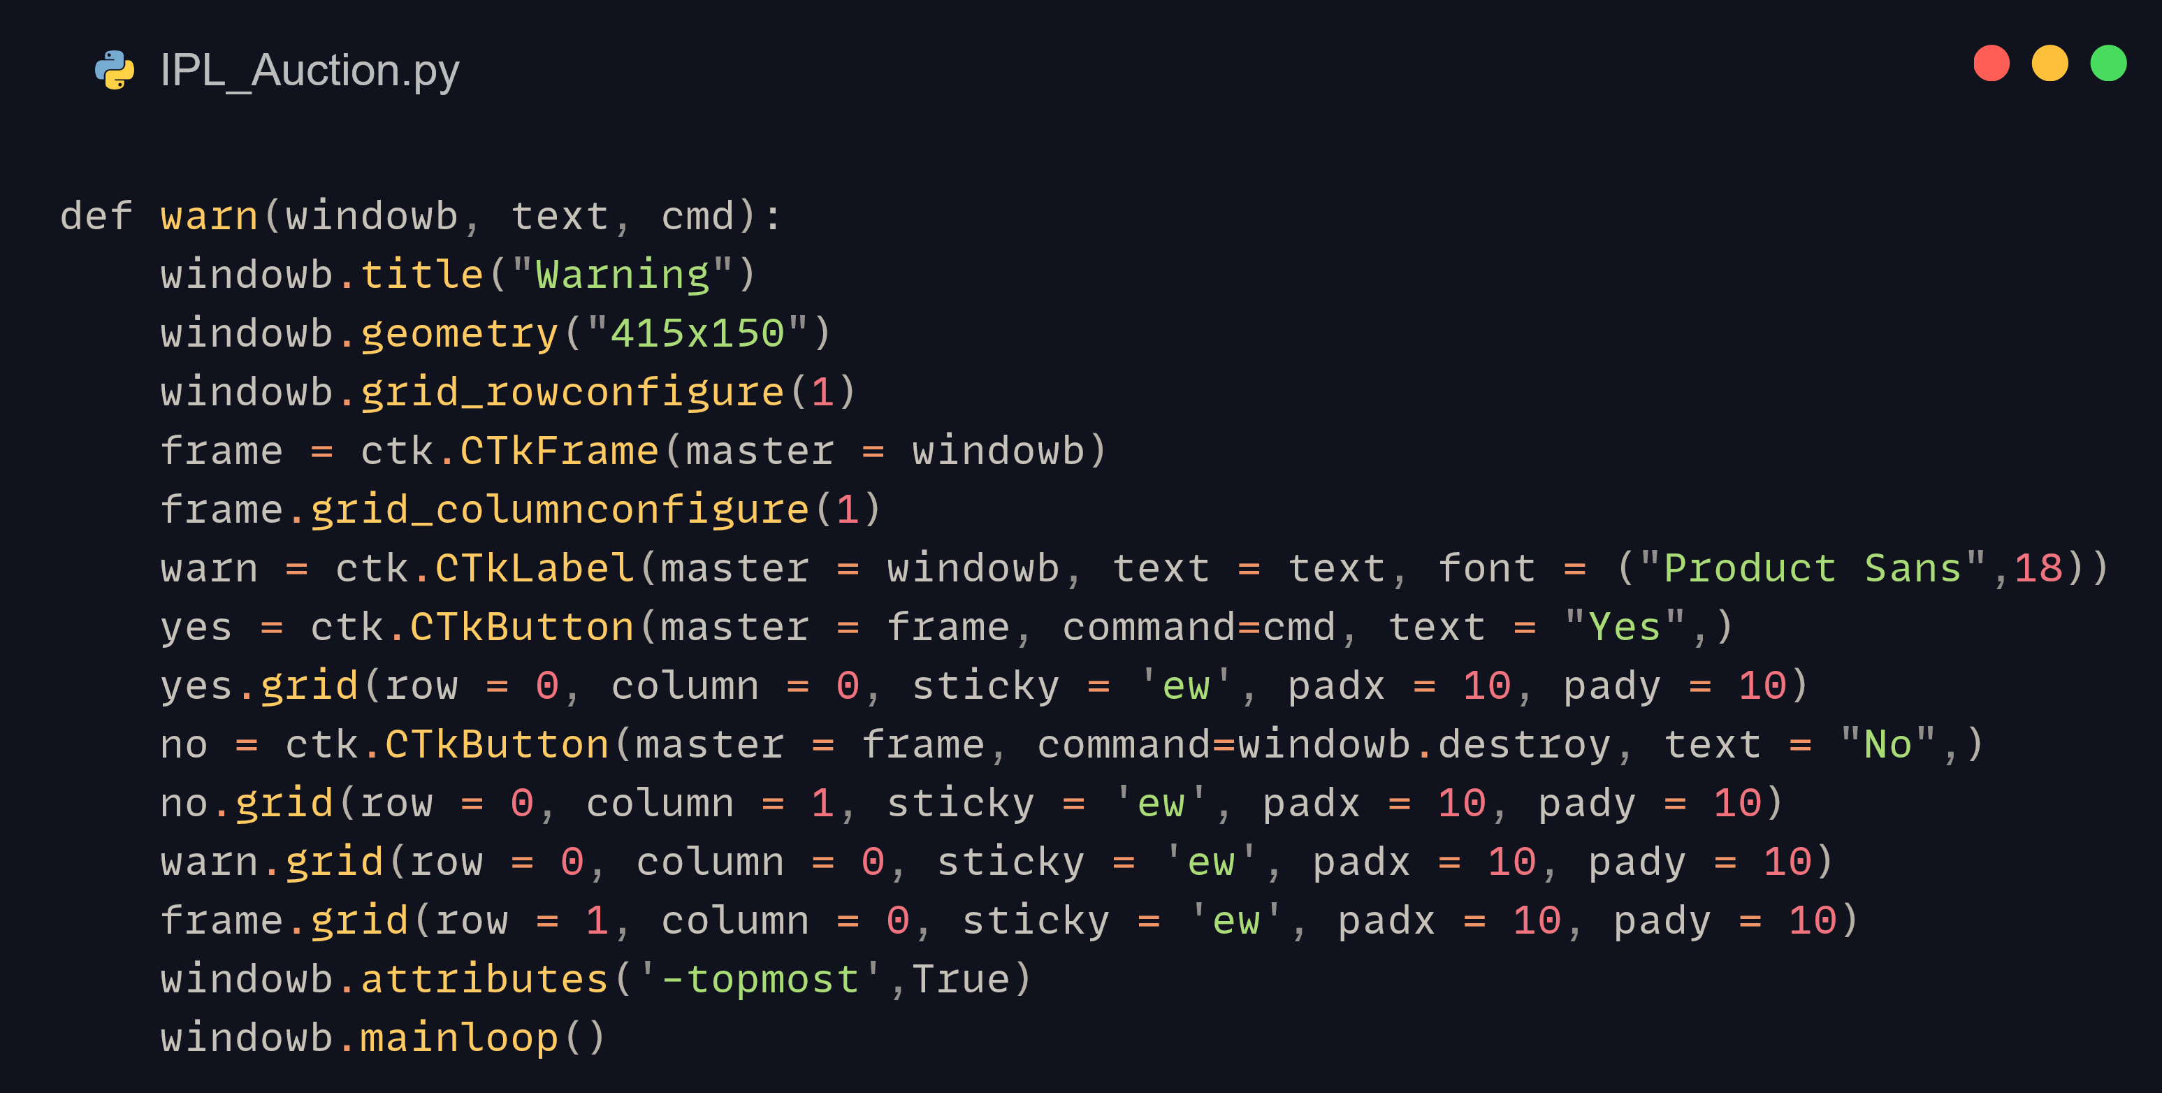
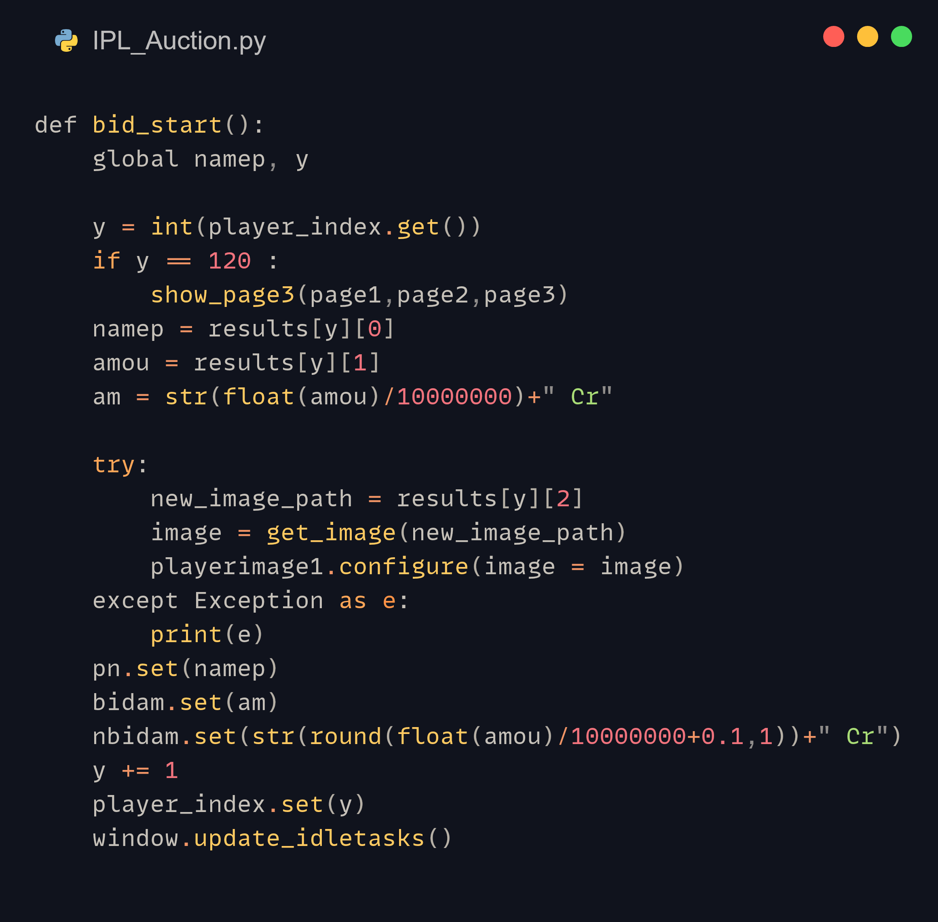
A functioned defined in the custom auction_lib libary
bid_start(),one of multiple Functions used in our program

Slide 15
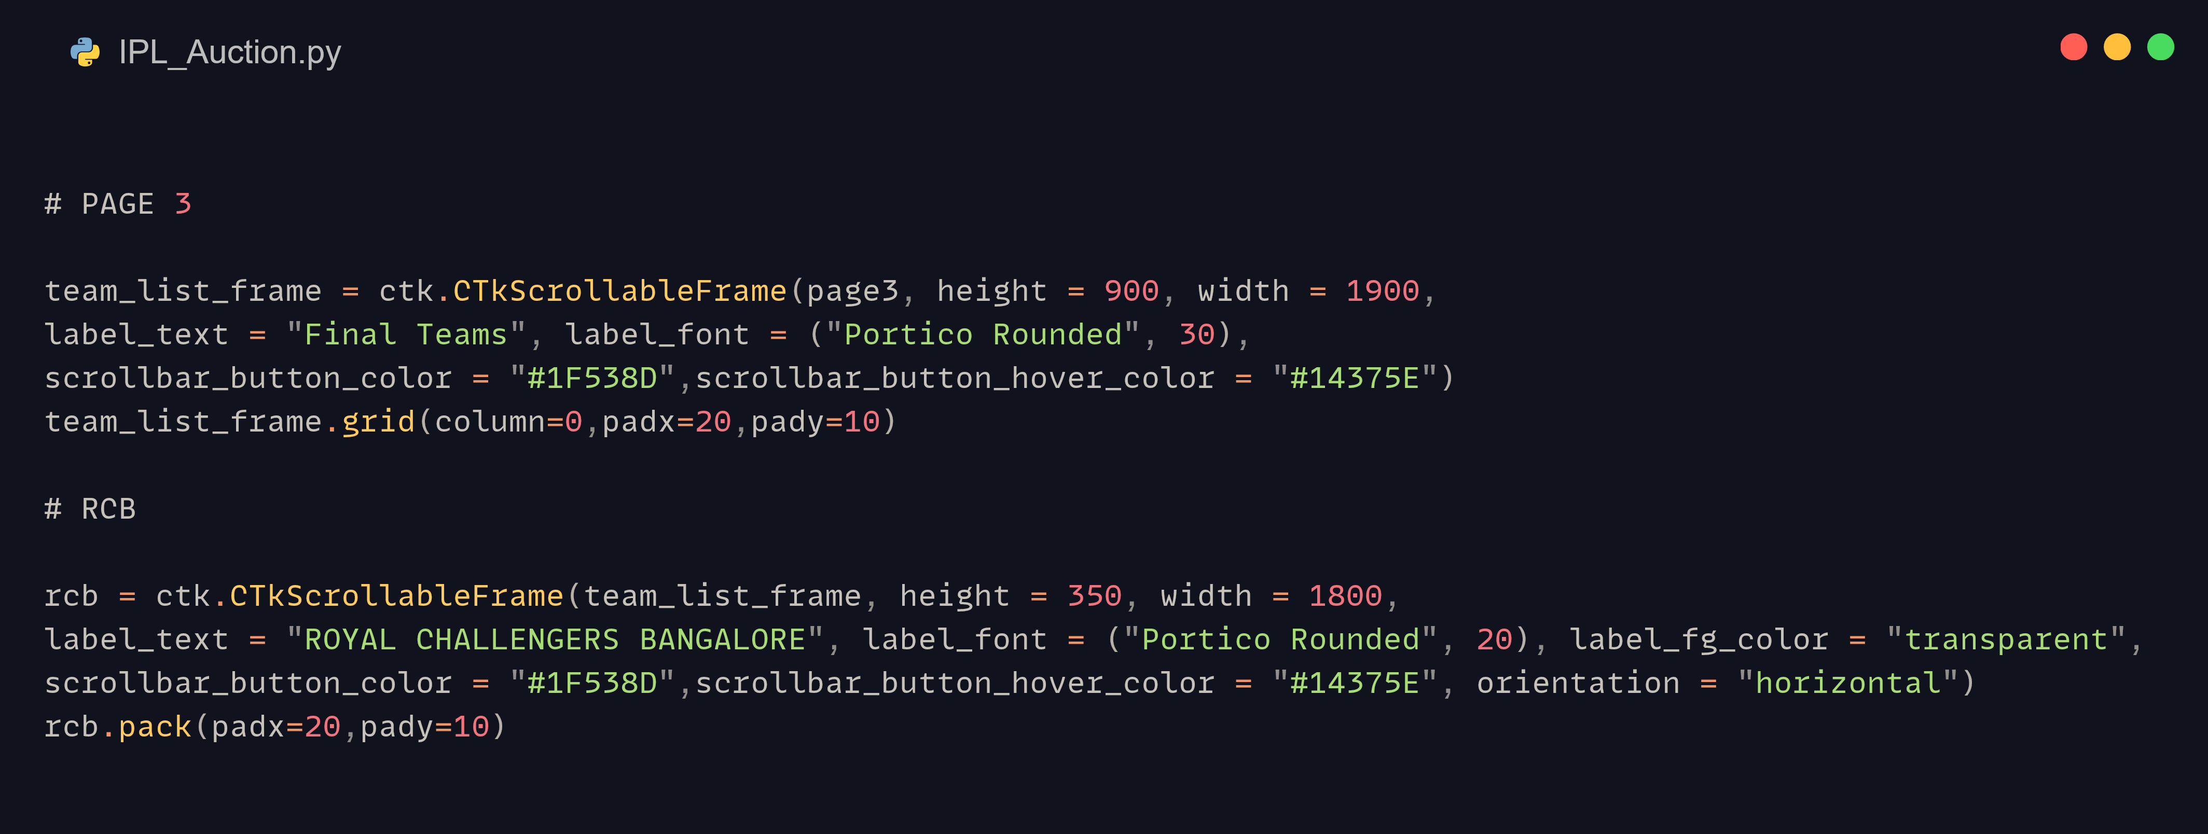
tKinter Code Snippet for the Final Teams screen (Page 3). This snippet displays the final team list of 15 players of a single team, with the others following suit

Slide 16
Results and discussion

Slide 17
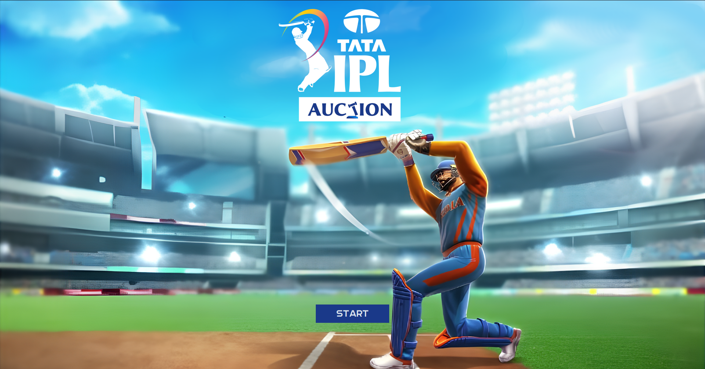

Slide 18
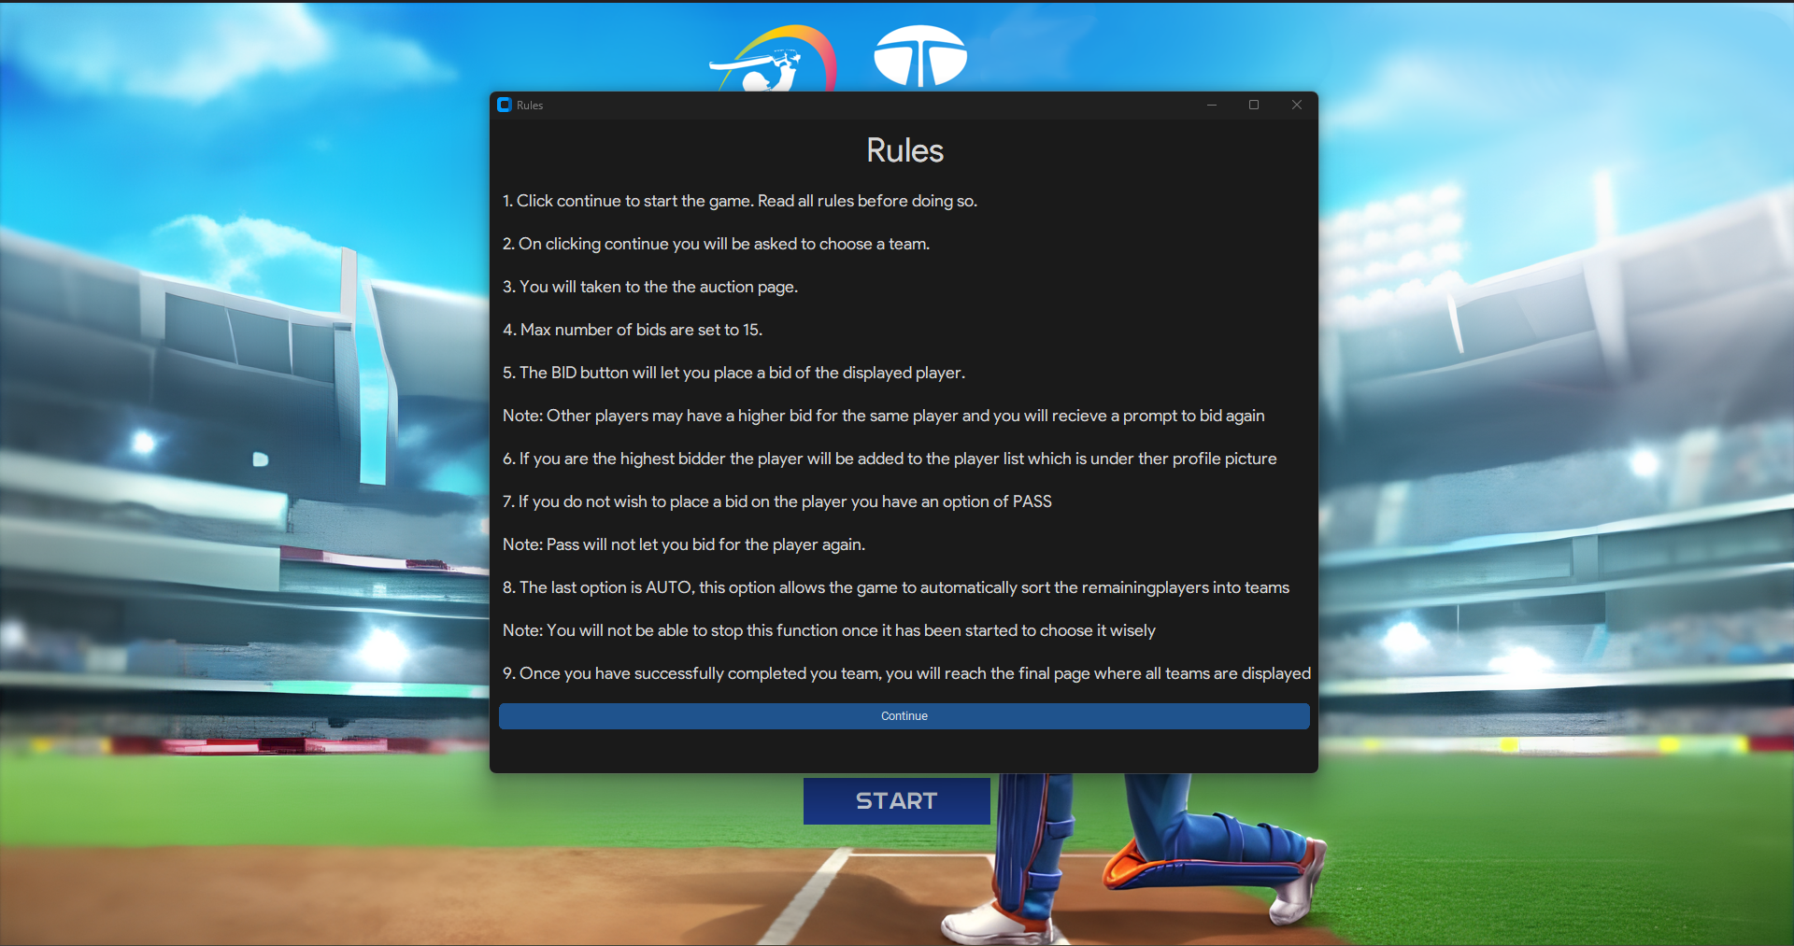

Slide 19
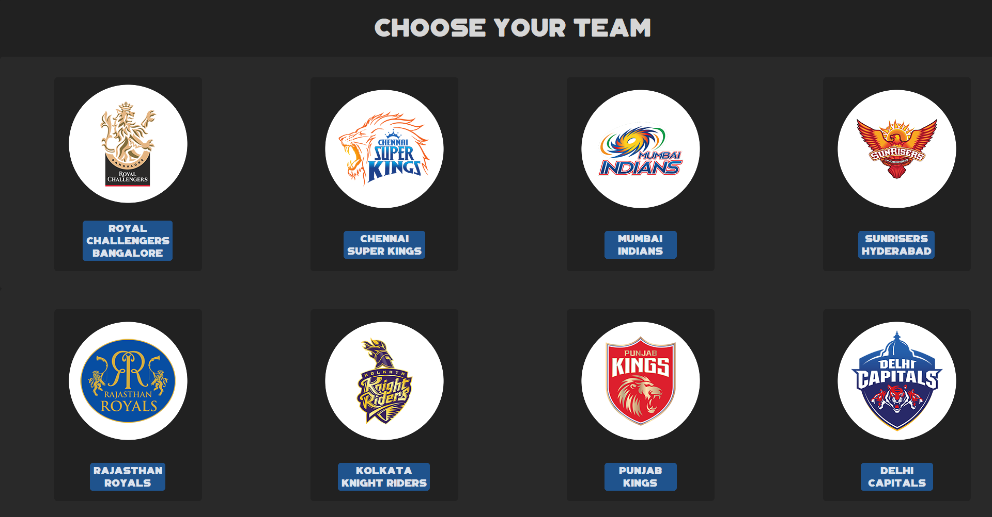

Slide 20
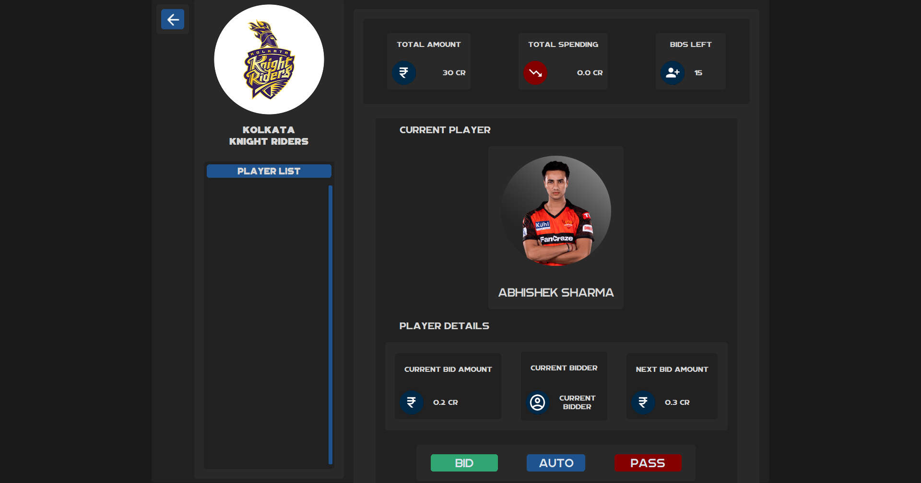

Slide 21
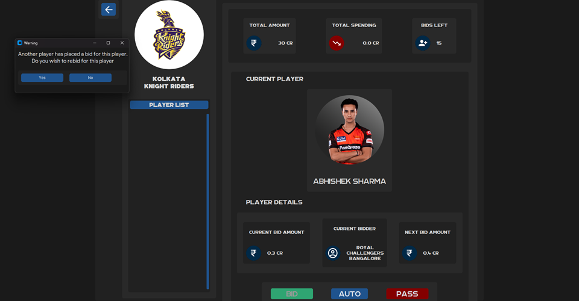

Slide 22
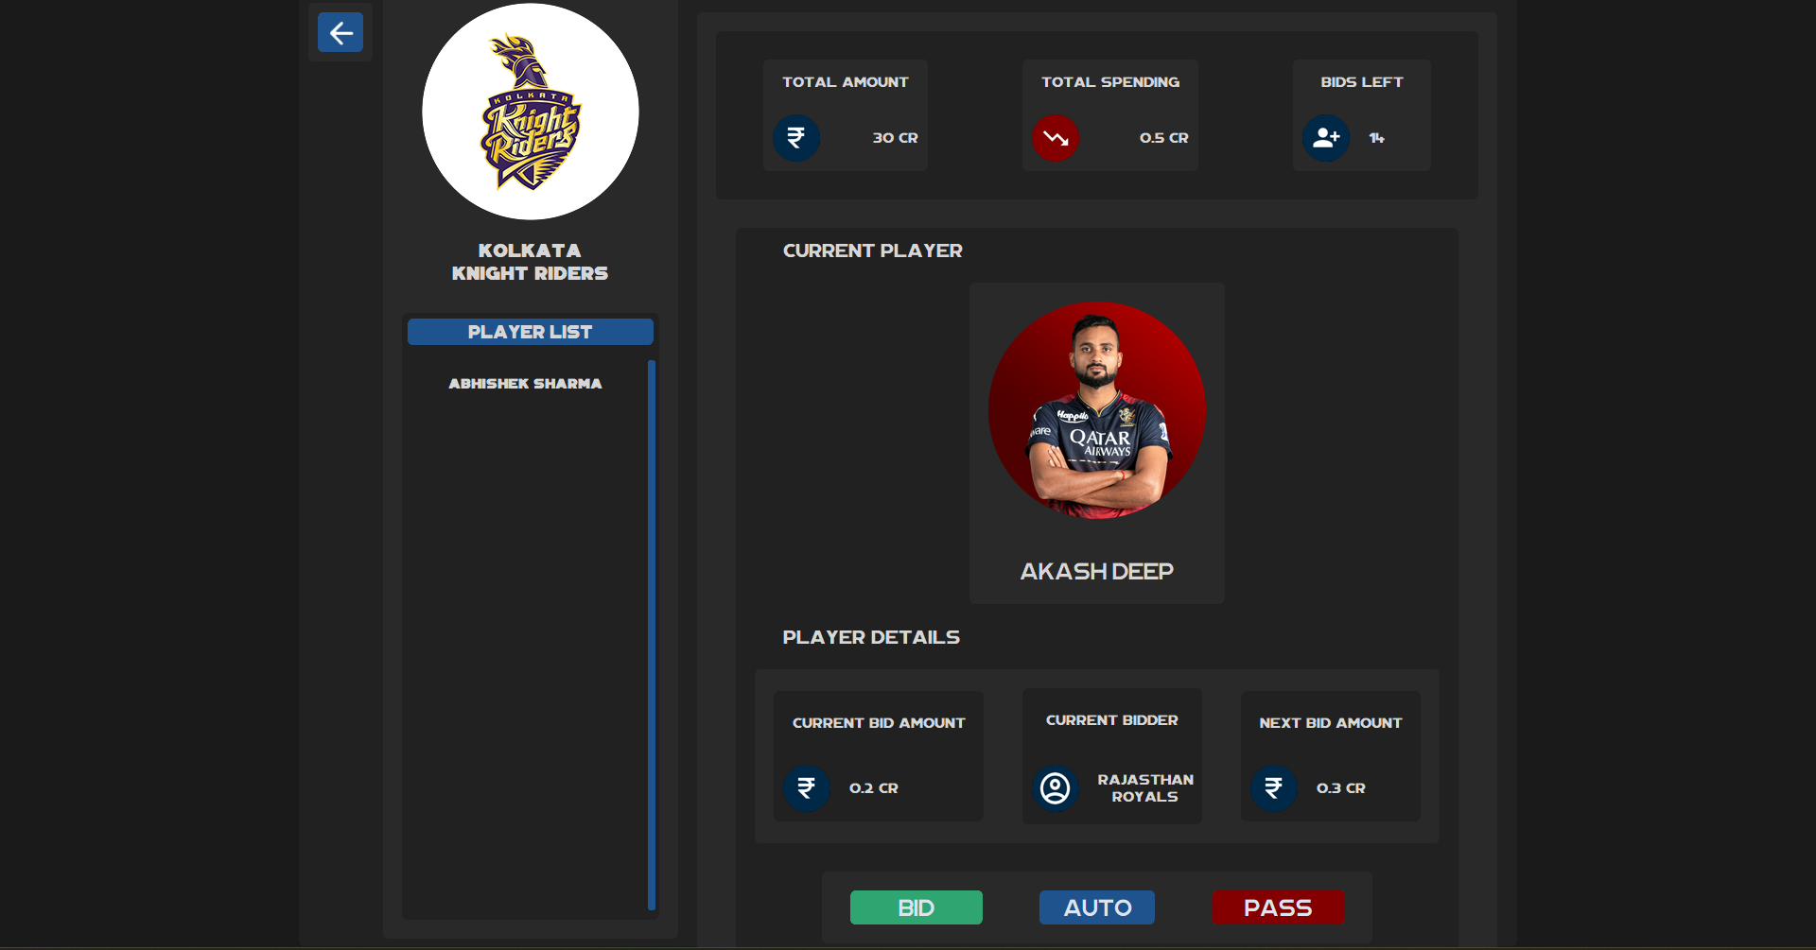

Slide 23
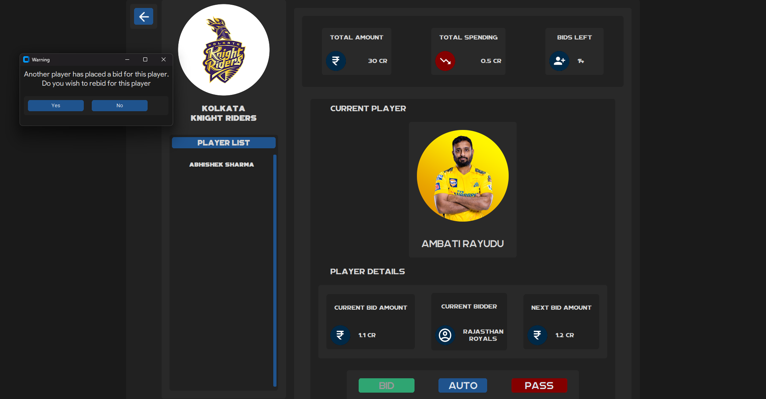

Slide 24
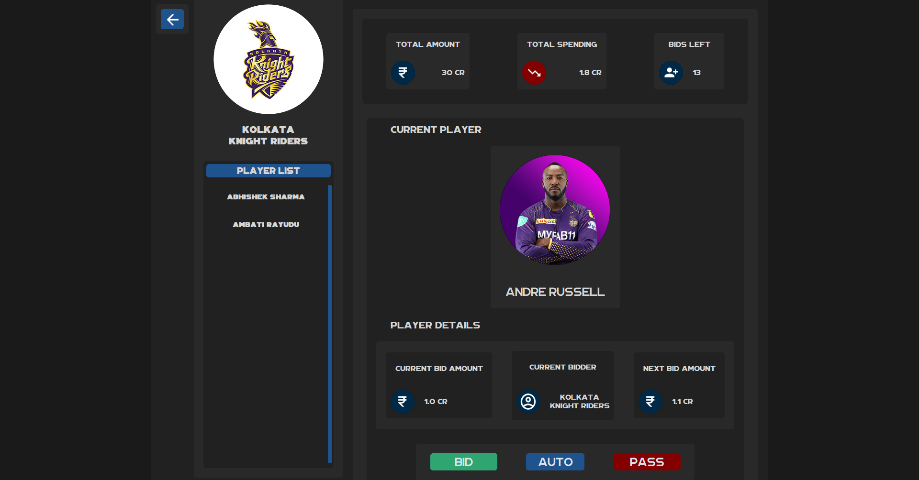

Slide 25
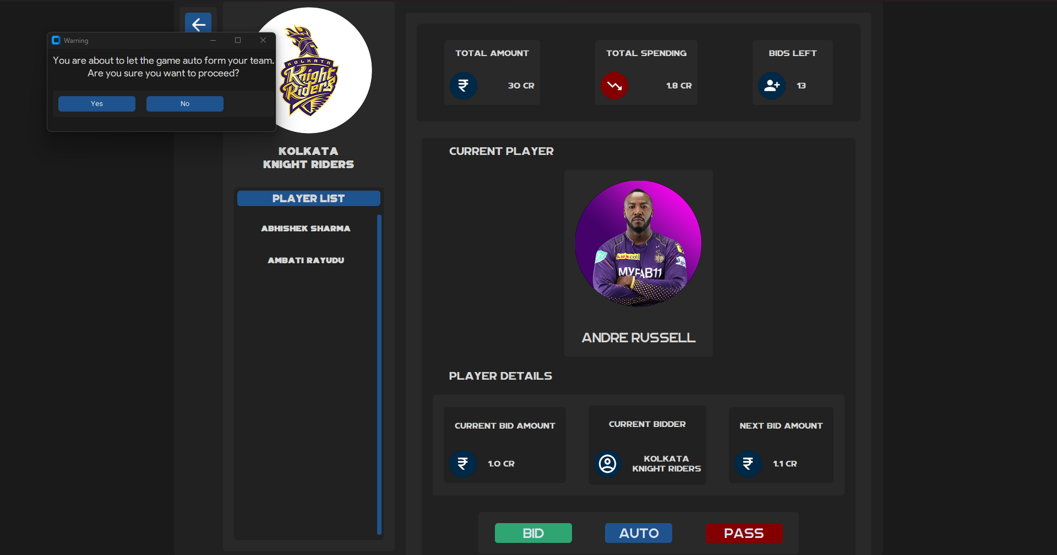

Slide 26
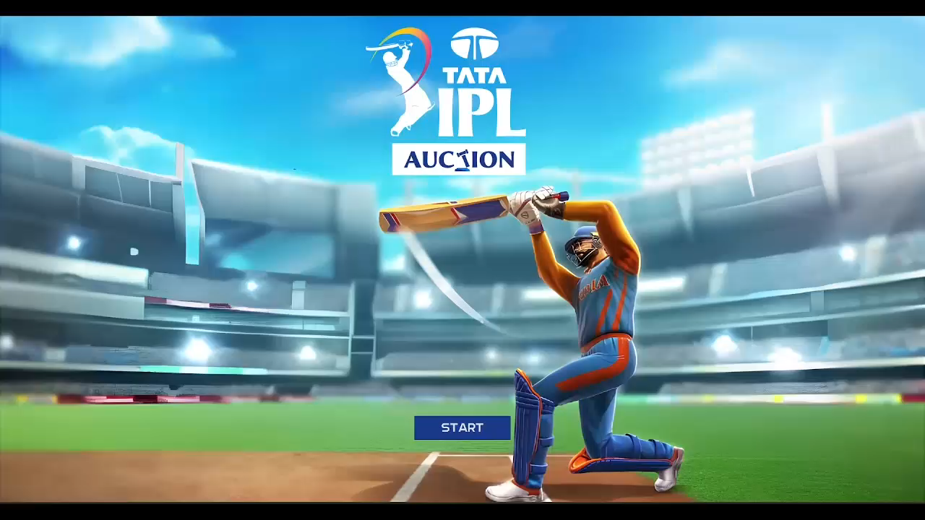

Slide 27
Learnings from the Project

Slide 28
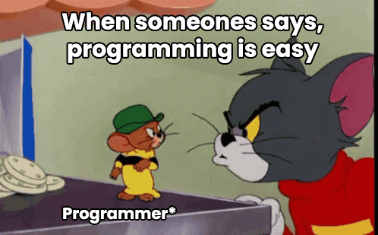

While working on this project, we definitely came across various obstacles that we had to debug and learn from. We used all the help we could get!

Slide 29


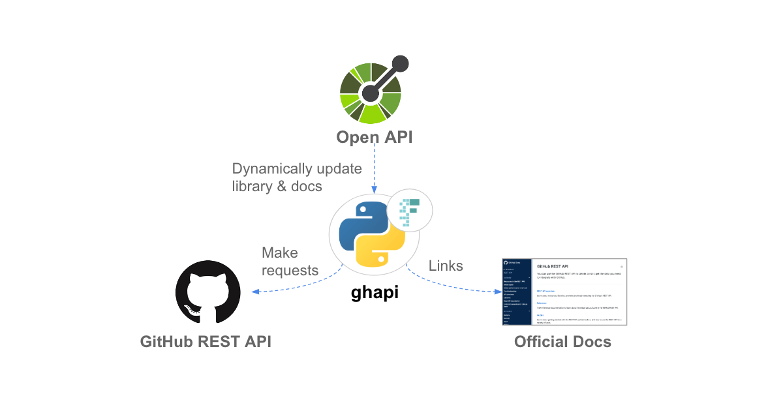
We learnt to work with advanced functions in Python, while getting a lot of help from the community around the language with all the various resources like custom built modules, and guides.

Slide 30

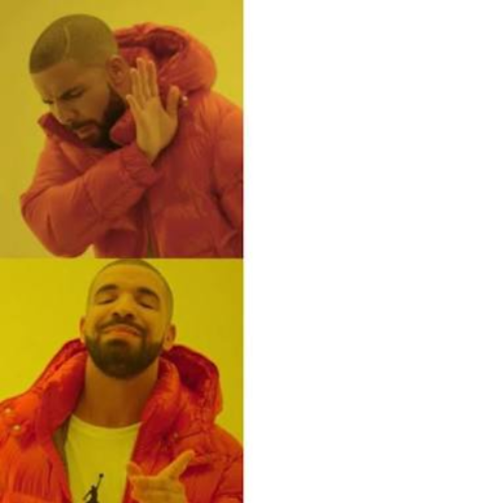
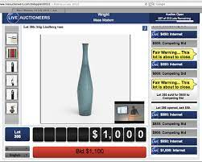
Working on this project also helped us understand working with databases in mySQL and also with designing a good Graphical User Interface (GUI) for our programs using tKinter.

Slide 31
Conclusions and Future Work

Slide 32
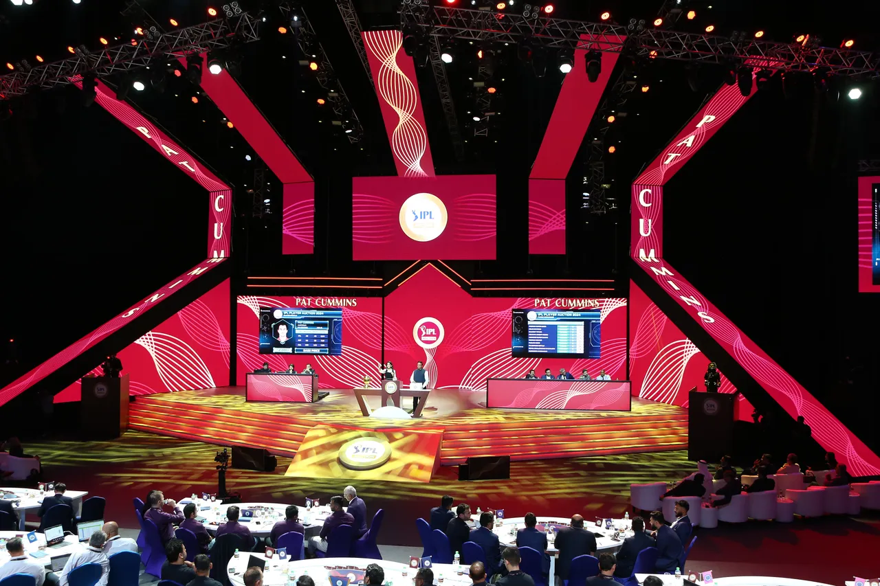
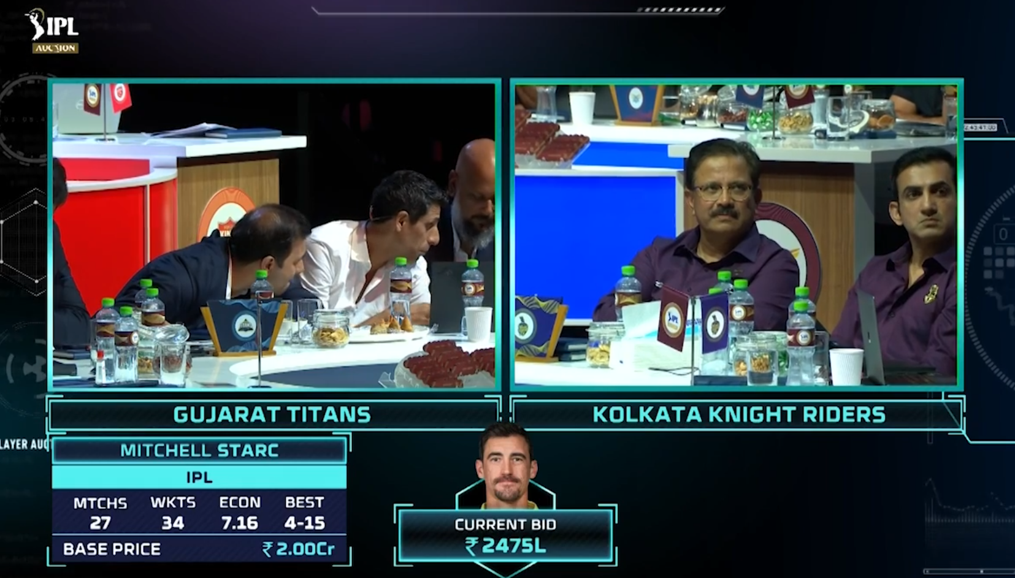
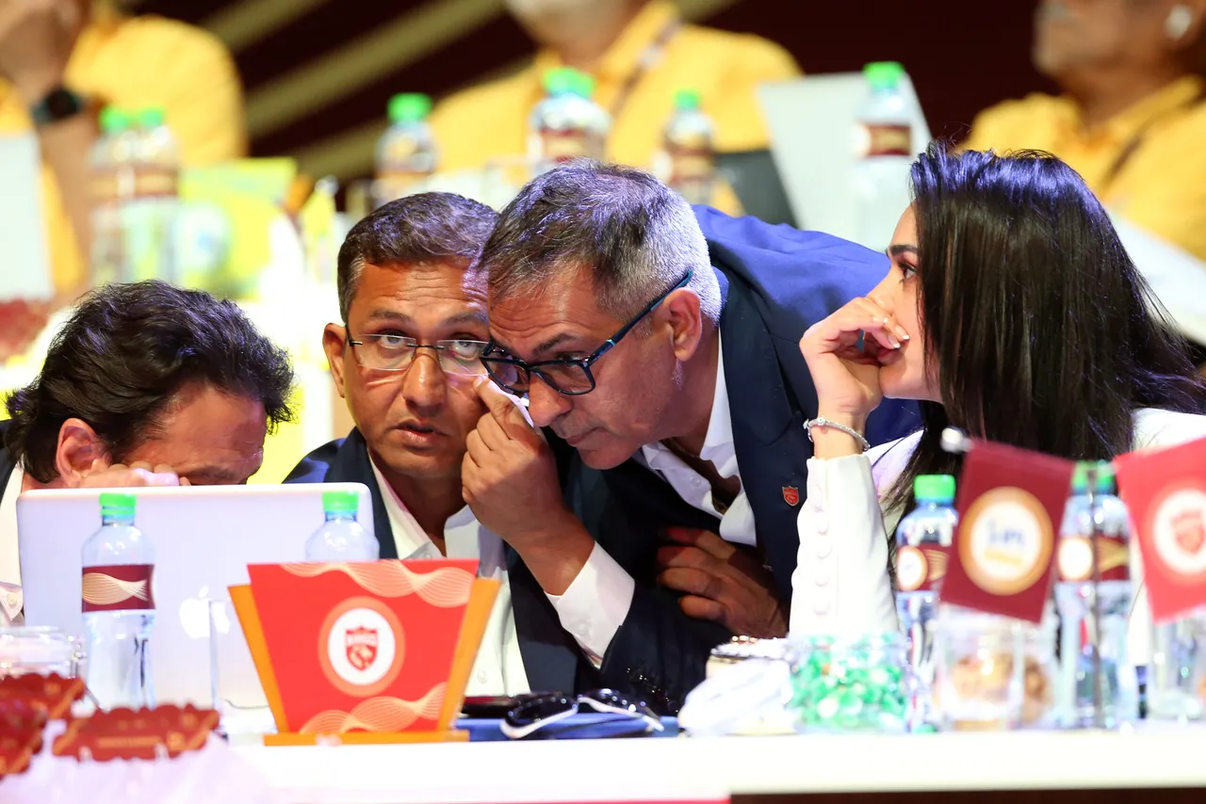
To conclude, this python project successfully simulates the basic structure of an IPL Auction we see every year.

Slide 33
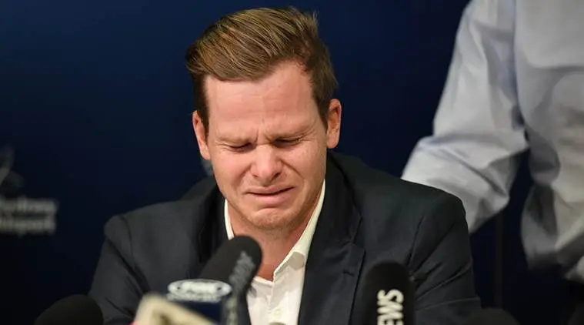



It could simulate all the memorable moments that cricket fans remember from auctions like Steve Smith being unsold or Mitchell Starc being sold for an absurdly high price of 24.75 crores.

Slide 34


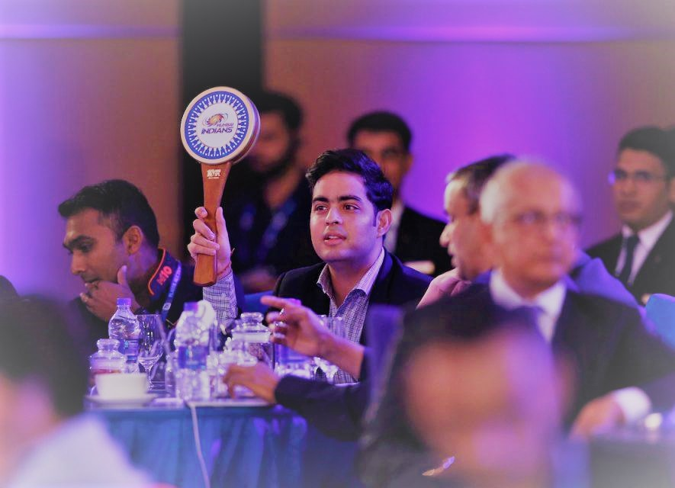
As far as future work goes, this project can easily be expanded across various domains of sport along with additional conditions that current IPL Auctions have like the old RTM (Right to Match) cards or any other custom rules. It can also be expanded for being usable by multiple users.

Slide 35


http://www.horriblegames.com
I feel like a true auctioneer now!!!!11!

Slide 36
References and Resources
Python and w3Schools
Official Documentation and Tutorials
https://www.python.org/doc/
https://www.w3schools.com/python/
GeekforGeeks, StackOverflow, and Youtube
Help in debugging errors in our Python code
https://www.geeksforgeeks.org/
https://stackoverflow.com/
https://www.youtube.com/
slidesGo , Snappify, and Google Images
Presentation Templates, Code Blocks, and Media Resources
https://stackoverflow.com/
https://www.google.com/imghp?hl=en
https://slidesgo.com/
https://snappify.com/

Slide 37
References and Resources
Github and Github Desktop
Service to host our project code and assets online/offline
https://code.visualstudio.com/
https://desktop.github.com/
Visual Studio Code (and necessary extensions)
Primary IDE for working with the code
https://code.visualstudio.com/
MySQL Workbench
Primary Software for an easy creation of a database for the program
https://www.mysql.com/products/workbench/

Slide 38
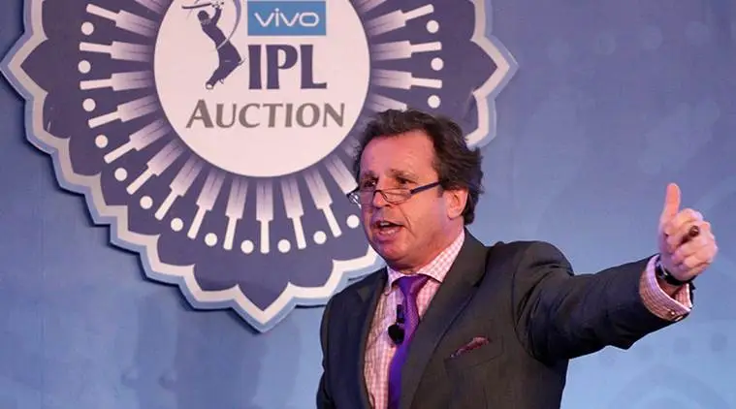

Now you can make the best IPL team of all time!!! Only to lose in the final ☺

Slide 39
Thanks!

Slide 40
